Slide 1
18
The Cardiovascular System: The Heart: Part A

Slide 2
Heart Anatomy
Approximately the size of a fist
Location
  In the mediastinum between second rib and fifth intercostal space
  On the superior surface of diaphragm
  Two-thirds to the left of the midsternal line
  Anterior to the vertebral column, posterior to the sternum
Enclosed in pericardium, a double-walled sac
PLAY
Animation: Rotatable heart

Slide 3
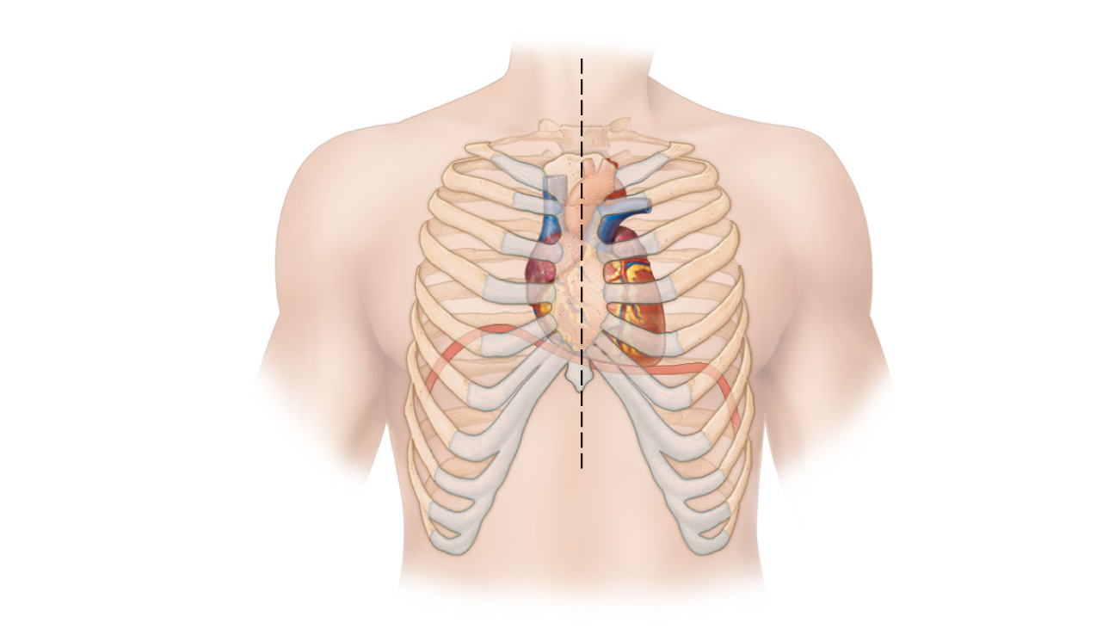
Midsternal line
2nd rib
Sternum
Diaphragm
Point of
maximal
intensity
(PMI)
(a)
Figure 18.1a

Slide 4
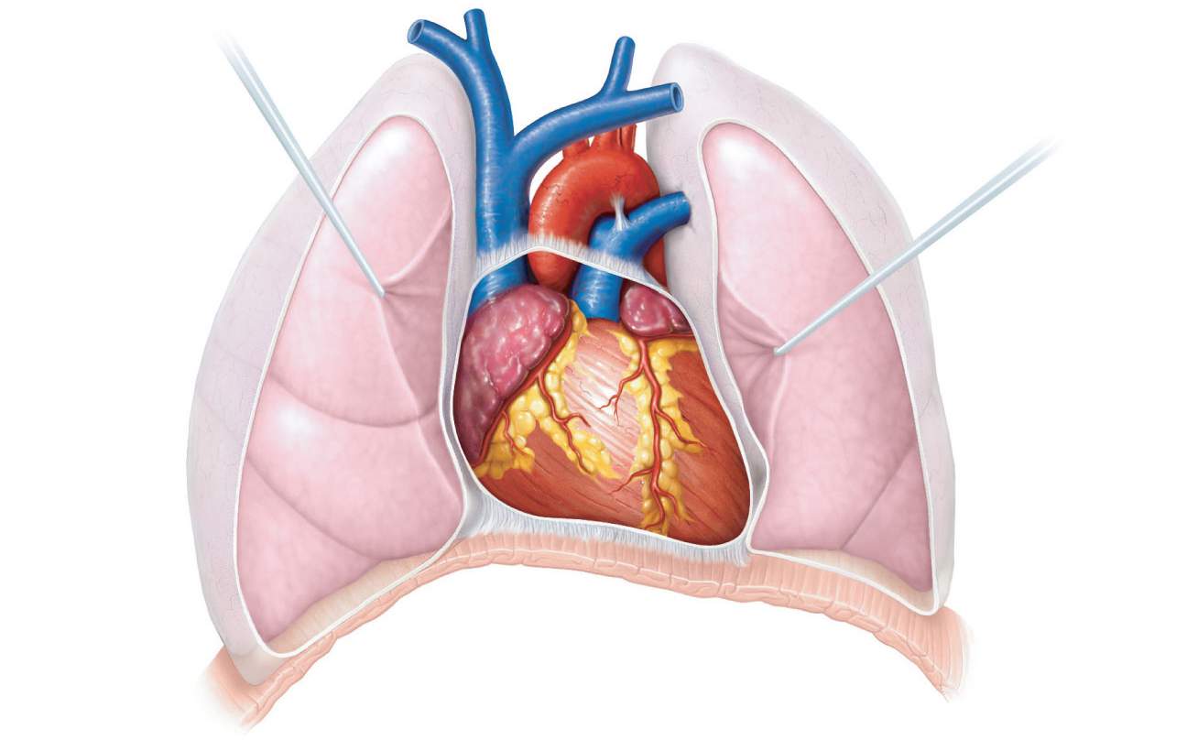
Superior
vena cava
Aorta
Parietal
pleura (cut)
Pulmonary
trunk
Left lung
Pericardium
(cut)
Apex of
heart
Diaphragm
(c)
Figure 18.1c

Slide 5
Pericardium
Superficial fibrous pericardium
    Protects, anchors, and prevents overfilling

Slide 6
Pericardium
Deep two-layered serous pericardium
  Parietal layer lines the internal surface of the fibrous pericardium
  Visceral layer (epicardium) on external surface of the heart
  Separated by fluid-filled pericardial cavity (decreases friction)

Slide 7
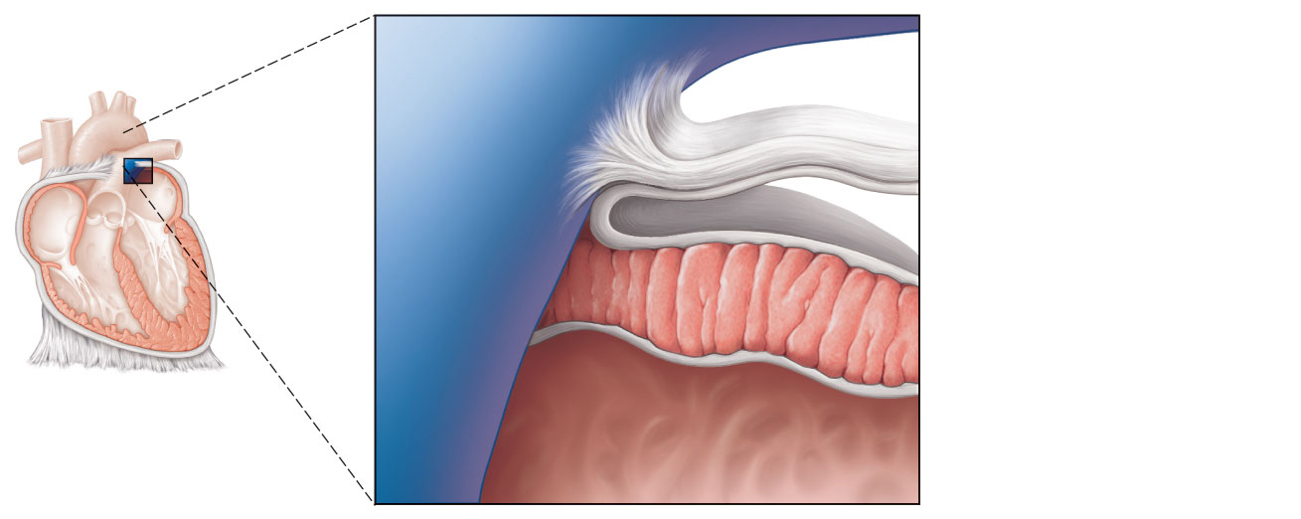
Pulmonary
trunk
Fibrous pericardium
Parietal layer of
serous pericardium
Pericardium
Pericardial cavity
Myocardium
Epicardium
(visceral layer
of serous
pericardium)
Heart
wall
Myocardium
Endocardium
Heart chamber
Figure 18.2

Slide 8
Layers of the Heart Wall
Epicardium—visceral layer of the serous pericardium

Slide 9
Layers of the Heart Wall
Myocardium
  Spiral bundles of cardiac muscle cells
  Fibrous skeleton of the heart: crisscrossing, interlacing layer of connective tissue
    Anchors cardiac muscle fibers
    Supports great vessels and valves
    Limits spread of action potentials to specific paths

Slide 10
Layers of the Heart Wall
Endocardium is continuous with endothelial lining of blood vessels

Slide 11
Pulmonary
trunk
Fibrous pericardium
Parietal layer of
serous pericardium
Pericardium
Pericardial cavity
Myocardium
Epicardium
(visceral layer
of serous
pericardium)
Heart
wall
Myocardium
Endocardium
Heart chamber
Figure 18.2

Slide 12
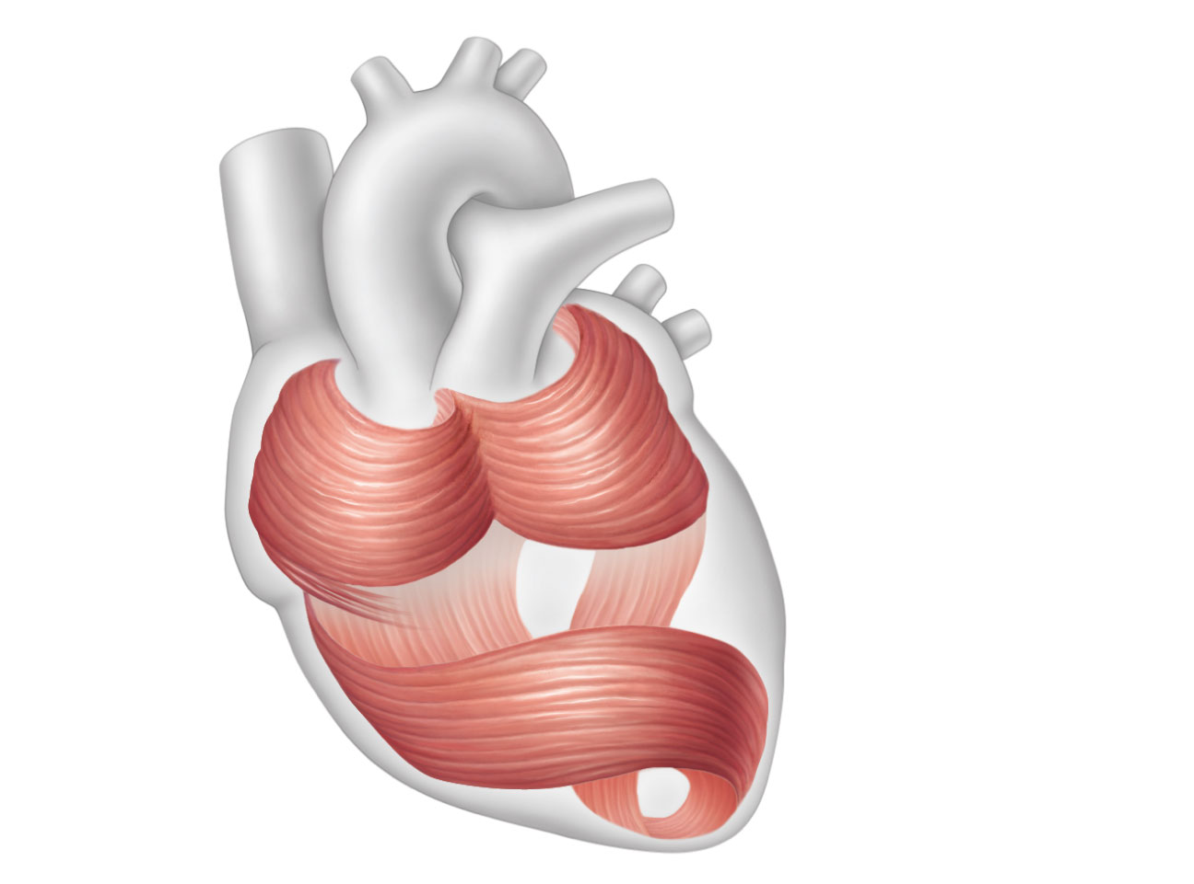
Cardiac
muscle
bundles
Figure 18.3

Slide 13
Chambers
Four chambers
  Two atria
    Separated internally by the interatrial septum
    Coronary sulcus (atrioventricular groove) encircles the junction of the atria and ventricles
    Auricles increase atrial volume

Slide 14
Chambers
Two ventricles
  Separated by the interventricular septum
  Anterior and posterior interventricular sulci mark the position of the septum externally

Slide 15
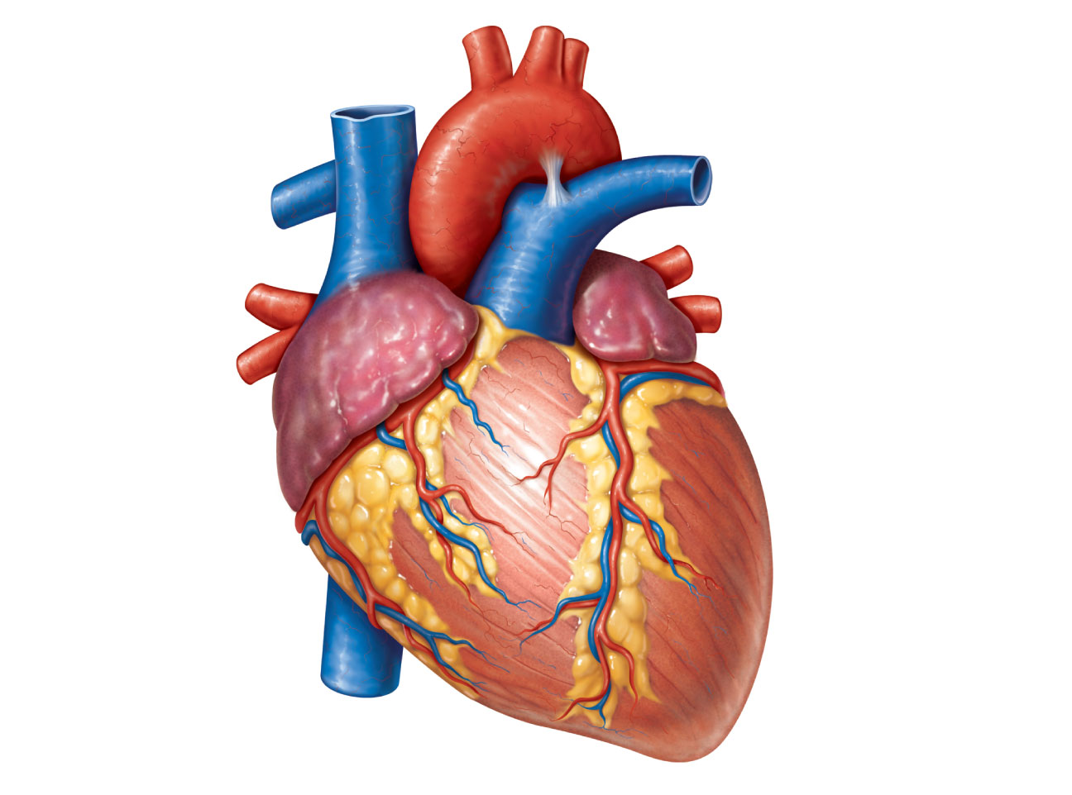
Brachiocephalic trunk
Left common carotid
artery
Left subclavian artery
Superior vena cava
Aortic arch
Right pulmonary
artery
Ligamentum arteriosum
Left pulmonary artery
Ascending aorta
Left pulmonary veins
Pulmonary trunk
Right pulmonary
veins
Auricle of
left atrium
Circumflex artery
Right atrium
Right coronary artery
(in coronary sulcus)
Left coronary artery
(in coronary sulcus)
Anterior cardiac vein
Left ventricle
Right ventricle
Right marginal artery
Great cardiac vein
Small cardiac vein
Anterior interventricular
artery (in anterior
interventricular sulcus)
Inferior vena cava
(b) Anterior view
Apex
Figure 18.4b

Slide 16
Atria: The Receiving Chambers
Walls are ridged by pectinate muscles
Vessels entering right atrium
  Superior vena cava
  Inferior vena cava
  Coronary sinus
Vessels entering left atrium
  Right and left pulmonary veins

Slide 17
Ventricles: The Discharging Chambers
Walls are ridged by trabeculae carneae
Papillary muscles project into the ventricular cavities
Vessel leaving the right ventricle
  Pulmonary trunk
Vessel leaving the left ventricle
  Aorta

Slide 18
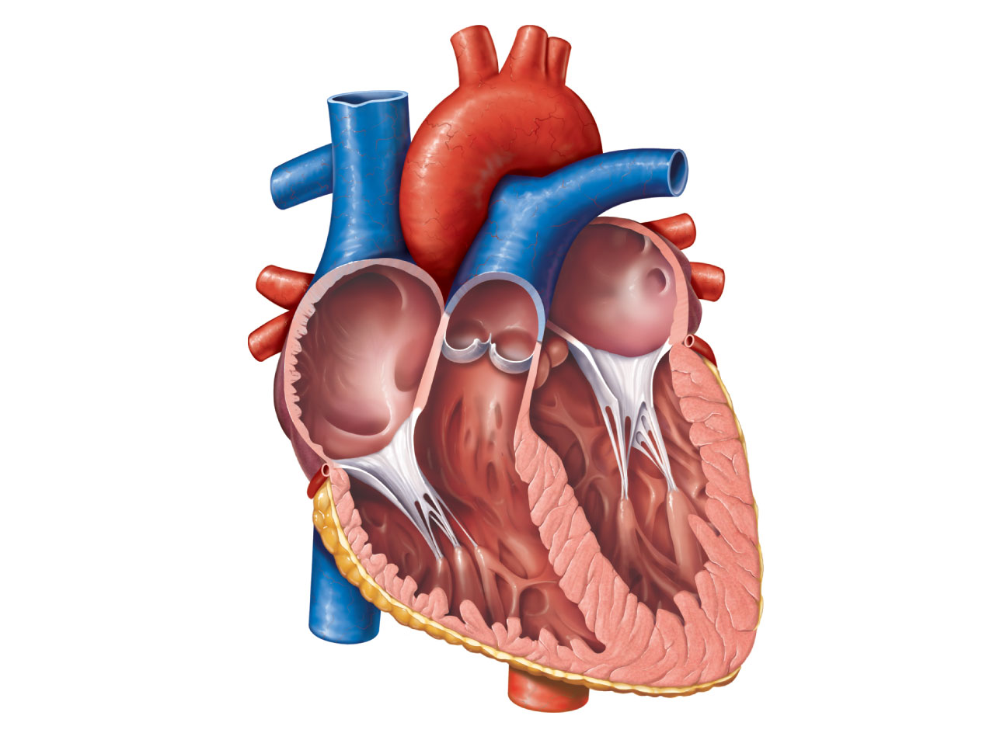
Aorta
Superior vena cava
Left pulmonary
artery
Right pulmonary
artery
Left atrium
Left pulmonary
veins
Pulmonary trunk
Right atrium
Mitral (bicuspid)
valve
Right pulmonary
veins
Fossa ovalis
Aortic valve
Pectinate muscles
Pulmonary valve
Tricuspid valve
Left ventricle
Right ventricle
Papillary muscle
Chordae tendineae
Interventricular
septum
Trabeculae carneae
Epicardium
Inferior vena cava
Myocardium
Endocardium
(e) Frontal section
Figure 18.4e

Slide 19
Pathway of Blood Through the Heart
The heart is two side-by-side pumps
  Right side is the pump for the pulmonary circuit
    Vessels that carry blood to and from the lungs
  Left side is the pump for the systemic circuit
    Vessels that carry the blood to and from all body tissues

Slide 20
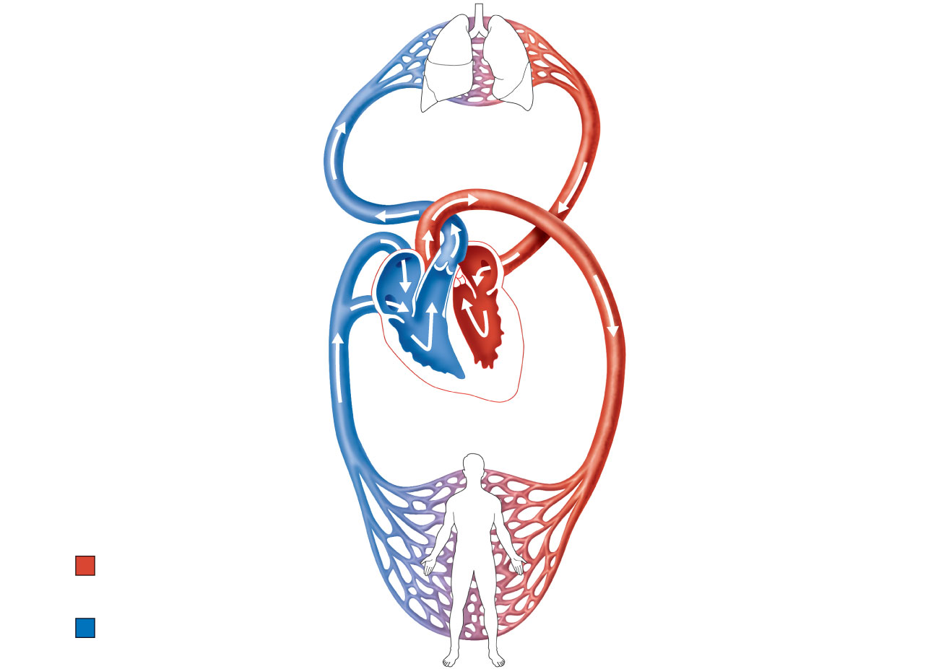
Capillary beds
of lungs where
gas exchange
occurs
Pulmonary
Circuit
Pulmonary arteries
Pulmonary veins
Aorta and branches
Venae cavae
Left atrium
Right atrium
Left ventricle
Heart
Right ventricle
Systemic
Circuit
Oxygen-rich,
CO₂-poor blood
Capillary beds of all
body tissues where
gas exchange occurs
Oxygen-poor,
CO₂-rich blood
Figure 18.5

Slide 21
Pathway of Blood Through the Heart
Right atrium → tricuspid valve → right ventricle
Right ventricle → pulmonary semilunar valve → pulmonary trunk → pulmonary arteries → lungs
PLAY
Animation: Rotatable heart (sectioned)

Slide 22
Pathway of Blood Through the Heart
Lungs → pulmonary veins → left atrium
Left atrium → bicuspid valve → left ventricle
Left ventricle → aortic semilunar valve → aorta
Aorta → systemic circulation
PLAY
Animation: Rotatable heart (sectioned)

Slide 23
Pathway of Blood Through the Heart
Equal volumes of blood are pumped to the pulmonary and systemic circuits
Pulmonary circuit is a short, low-pressure circulation
Systemic circuit blood encounters much resistance in the long pathways
Anatomy of the ventricles reflects these differences

Slide 24
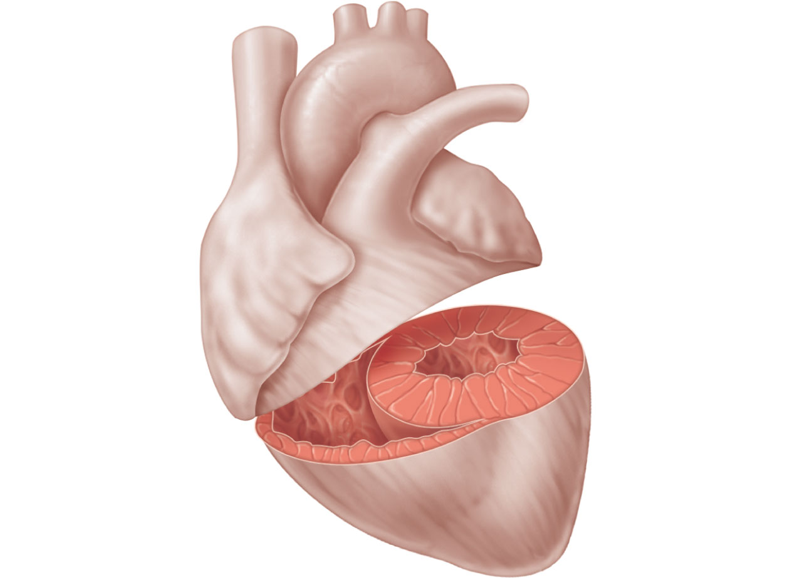
Left
ventricle
Right
ventricle
Interventricular
septum
Figure 18.6

Slide 25
Coronary Circulation
The functional blood supply to the heart muscle itself
Arterial supply varies considerably and contains many anastomoses (junctions) among branches
Collateral routes provide additional routes for blood delivery

Slide 26
Coronary Circulation
Arteries
  Right and left coronary (in atrioventricular groove), marginal, circumflex, and anterior interventricular arteries
Veins
  Small cardiac, anterior cardiac, and great cardiac veins

Slide 27
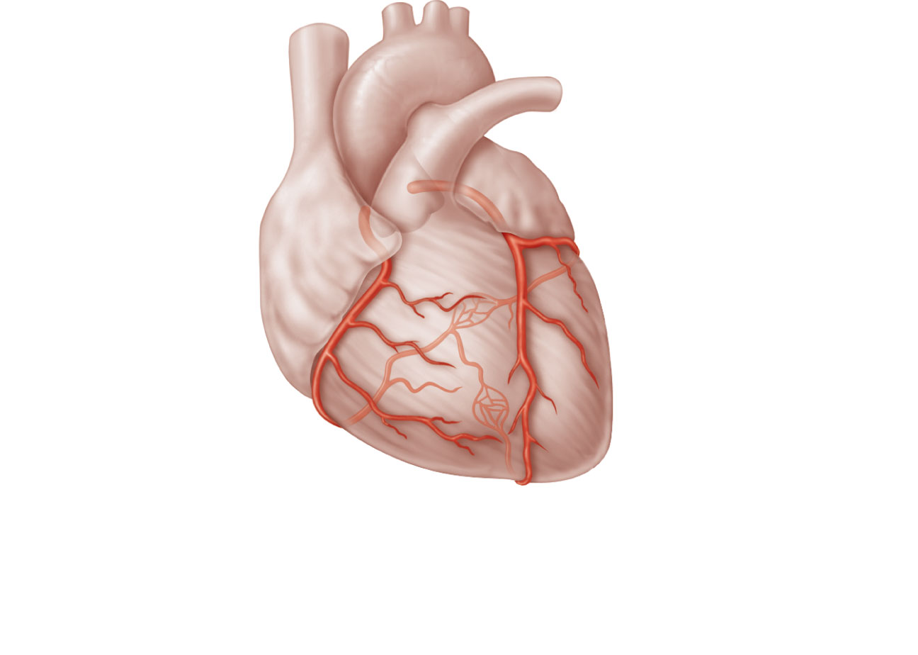
Aorta
Superior
vena cava
Pulmonary
trunk
Left atrium
Anastomosis
(junction of
vessels)
Left
coronary
artery
Right
atrium
Circumflex
artery
Right
coronary
artery
Left
ventricle
Right
ventricle
Anterior
interventricular
artery
Right
marginal
artery
Posterior
interventricular
artery
(a) The major coronary arteries
Figure 18.7a

Slide 28
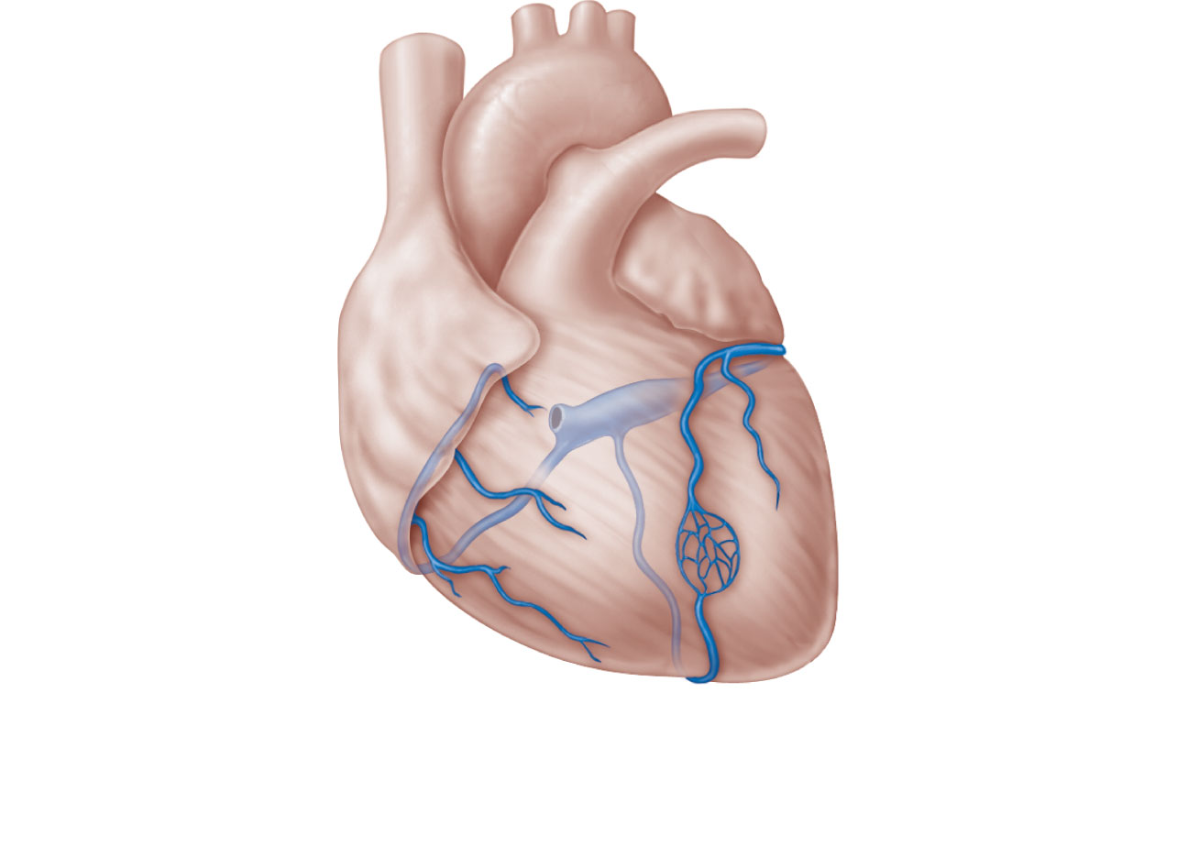
Superior
vena cava
Anterior
cardiac
veins
Great
cardiac
vein
Coronary
sinus
Small cardiac vein
Middle cardiac vein
(b) The major cardiac veins
Figure 18.7b

Slide 29
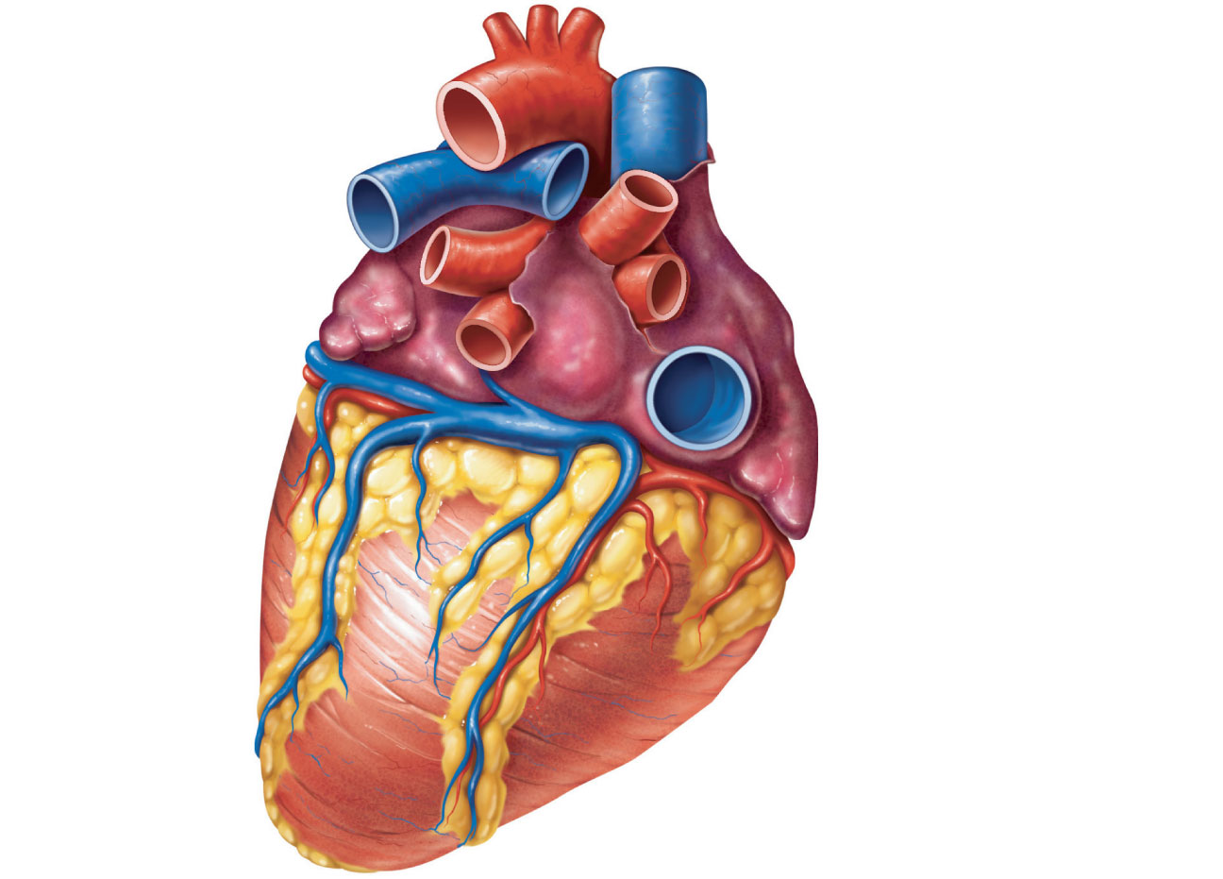
Aorta
Superior vena cava
Left pulmonary
artery
Right pulmonary artery
Left pulmonary
veins
Right pulmonary veins
Auricle of left
atrium
Right atrium
Left atrium
Inferior vena cava
Great cardiac
vein
Coronary sinus
Right coronary artery
(in coronary sulcus)
Posterior vein
of left ventricle
Posterior
interventricular
artery (in posterior
interventricular sulcus)
Left ventricle
Apex
Middle cardiac vein
Right ventricle
(d) Posterior surface view
Figure 18.4d

Slide 30
Homeostatic Imbalances
Angina pectoris
  Thoracic pain caused by a fleeting deficiency in blood delivery to the myocardium
  Cells are weakened
Myocardial infarction (heart attack)
  Prolonged coronary blockage
  Areas of cell death are repaired with noncontractile scar tissue

Slide 31
Heart Valves
Ensure unidirectional blood flow through the heart
Atrioventricular (AV) valves
  Prevent backflow into the atria when ventricles contract
  Tricuspid valve (right)
  Mitral valve (left)
Chordae tendineae anchor AV valve cusps to papillary muscles

Slide 32
Heart Valves
Semilunar (SL) valves
  Prevent backflow into the ventricles when ventricles relax
  Aortic semilunar valve
  Pulmonary semilunar valve

Slide 33
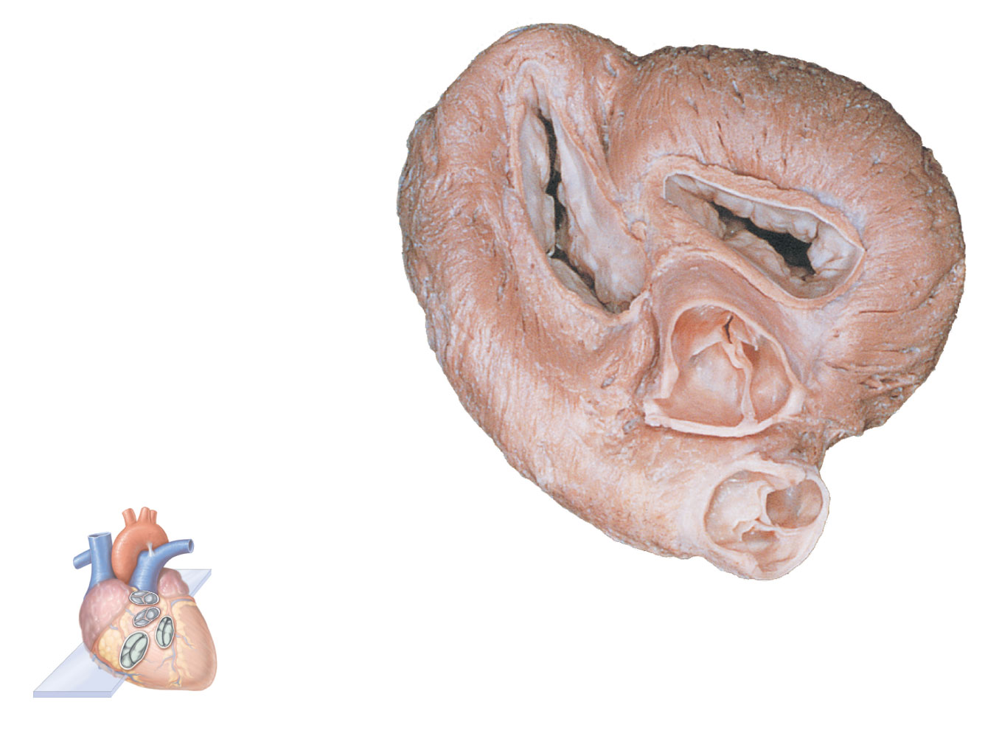
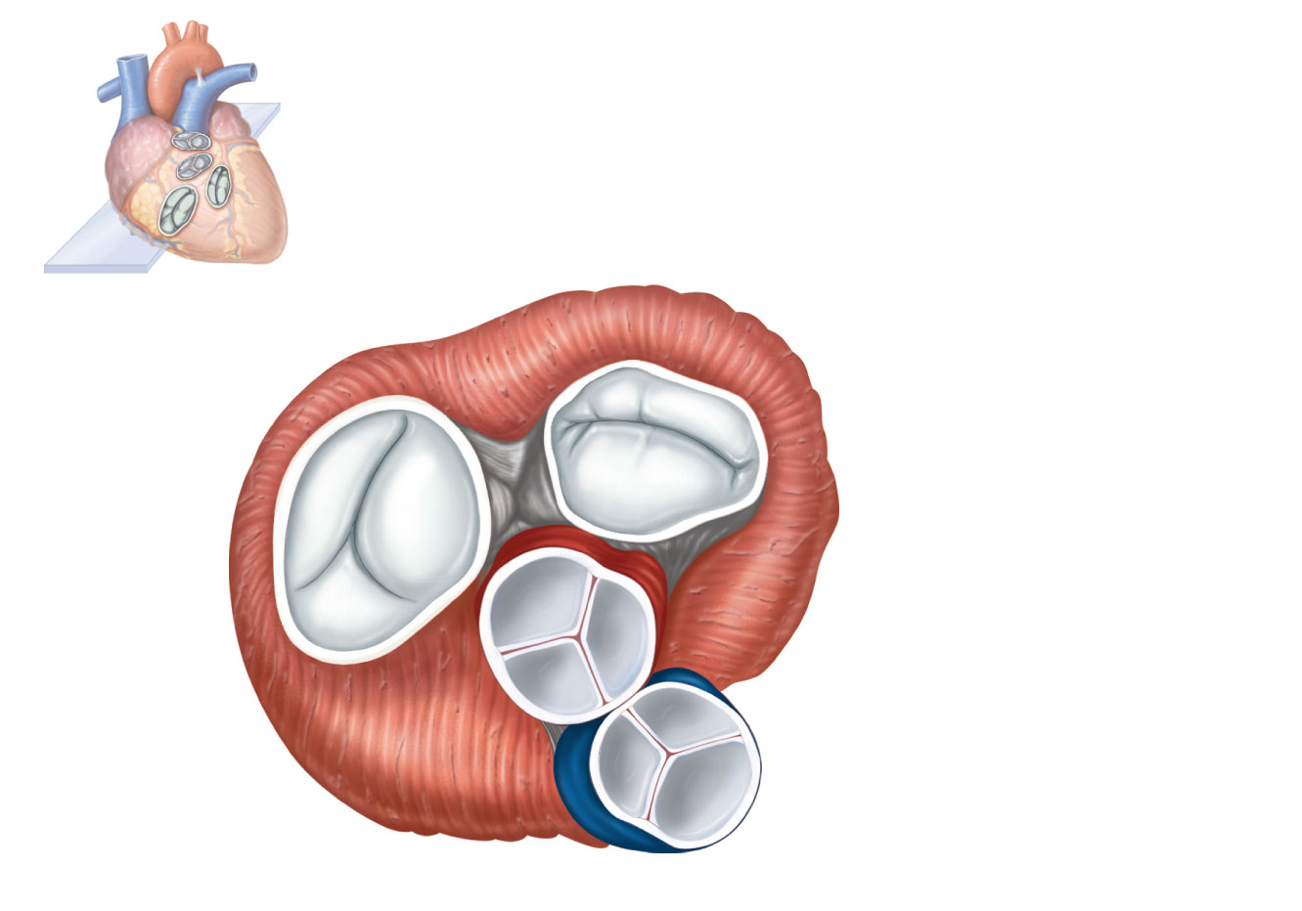
Myocardium
Pulmonary valve
Aortic valve
Tricuspid
(right atrioventricular)
valve
Area of cutaway
Mitral valve
Tricuspid valve
Mitral
(left atrioventricular)
valve
Myocardium
Tricuspid
(right atrioventricular)
valve
Aortic
valve
Mitral
(left atrioventricular)
valve
Pulmonary
valve
Aortic valve
Pulmonary valve
Aortic valve
Pulmonary
valve
Area of cutaway
(b)
Fibrous
skeleton
Mitral valve
(a)
Tricuspid valve
Anterior
Figure 18.8a

Slide 34
Myocardium
Tricuspid
(right atrioventricular)
valve
Mitral
(left atrioventricular)
valve
Aortic
valve
Pulmonary
valve
Pulmonary valve
Aortic valve
Area of cutaway
(b)
Mitral valve
Tricuspid valve
Figure 18.8b

Slide 35
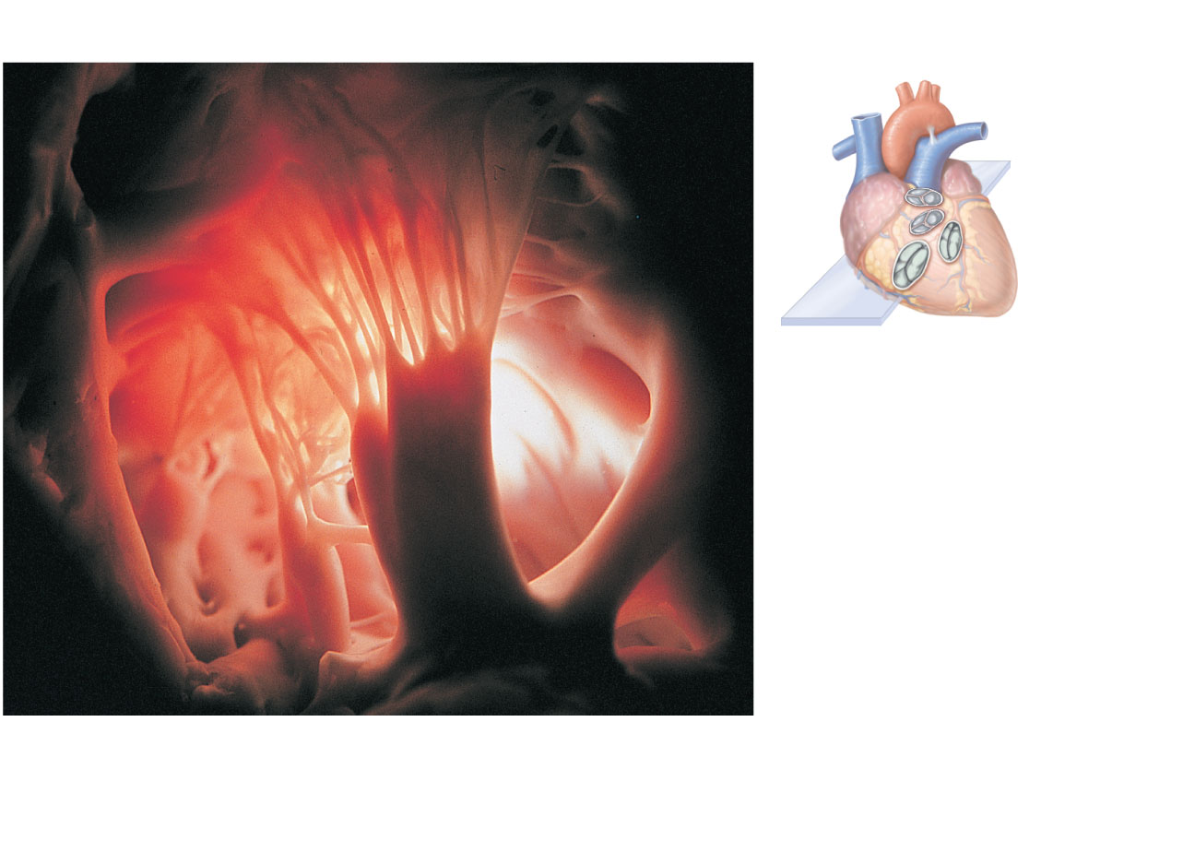
Pulmonary
valve
Aortic
valve
Area of
cutaway
Mitral
valve
Tricuspid
valve
Chordae tendineae
attached to tricuspid valve flap
Papillary
muscle
(c)
Figure 18.8c

Slide 36
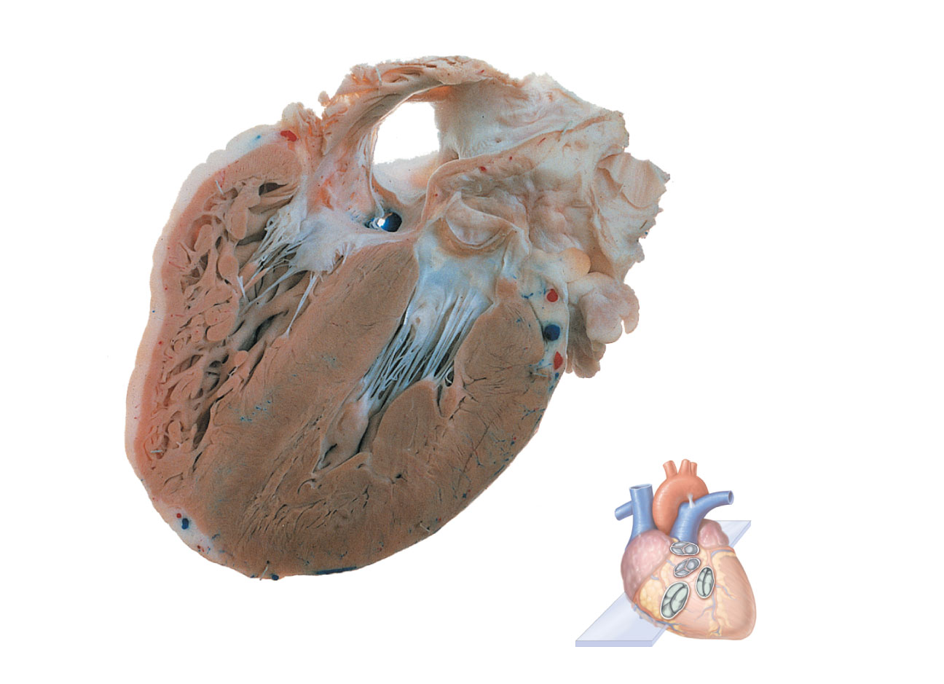
Opening of inferior
vena cava
Mitral valve
Chordae
tendineae
Tricuspid valve
Myocardium
of right
ventricle
Myocardium
of left ventricle
Pulmonary
valve
Aortic valve
Area of
cutaway
Papillary
muscles
Interventricular
septum
Mitral valve
Tricuspid
valve
(d)
Figure 18.8d

Slide 37
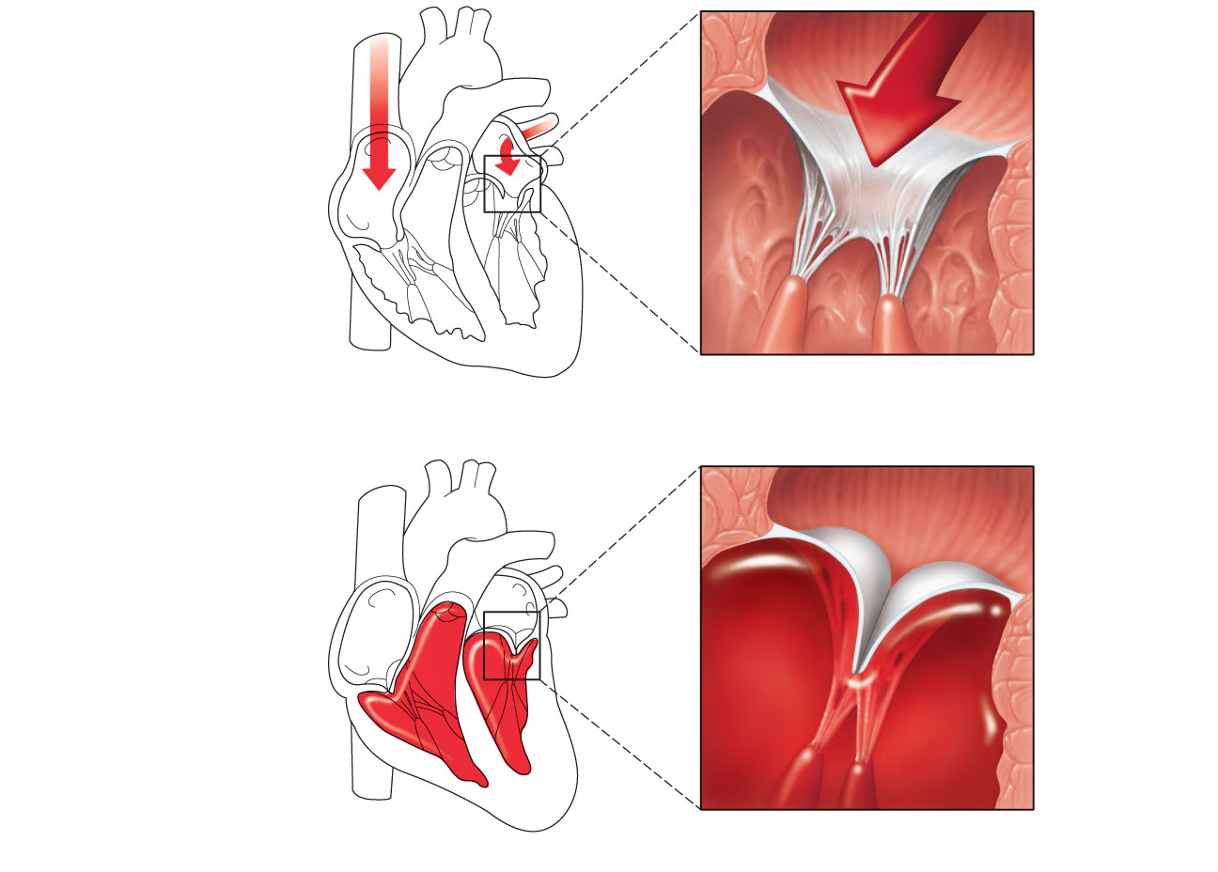
1
Blood returning to the
heart fills atria, putting
pressure against
atrioventricular valves;
atrioventricular valves are
forced open.
Direction of
blood flow
Atrium
Cusp of
atrioventricular
valve (open)
2
As ventricles fill,
atrioventricular valve flaps
hang limply into ventricles.
3
Chordae
tendineae
Atria contract, forcing
additional blood into ventricles.
Papillary
muscle
Ventricle
(a) AV valves open; atrial pressure greater than ventricular pressure
Atrium
1
Ventricles contract, forcing
blood against atrioventricular
valve cusps.
Cusps of
atrioventricular
valve (closed)
2
Atrioventricular valves
close.
Blood in
ventricle
3
Papillary muscles
contract and chordae
tendineae tighten,
preventing valve flaps
from everting into atria.
(b) AV valves closed; atrial pressure less than ventricular pressure
Figure 18.9

Slide 38
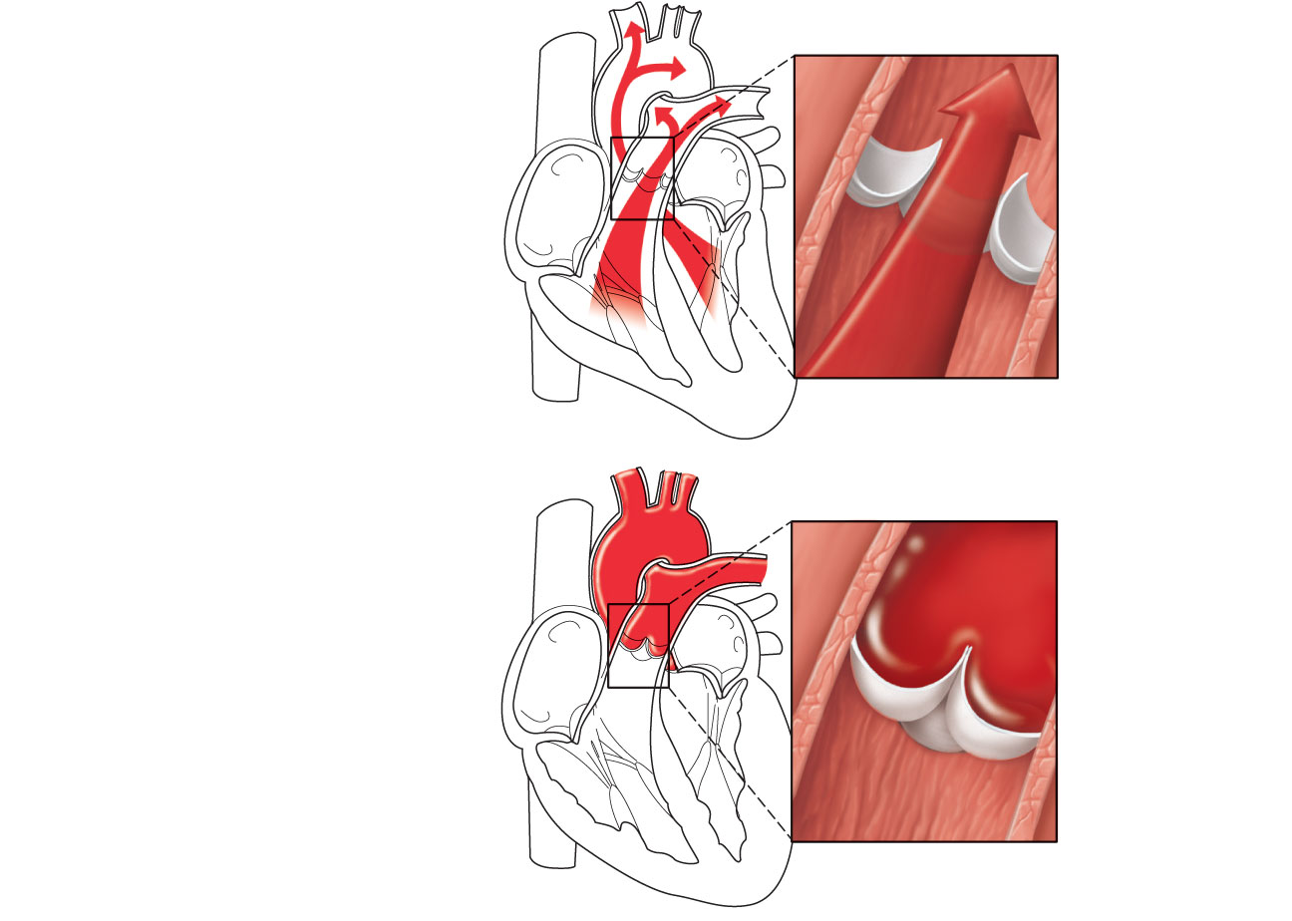
Aorta
Pulmonary
trunk
As ventricles
contract and
intraventricular
pressure rises,
blood is pushed up
against semilunar
valves, forcing them
open.
(a) Semilunar valves open
As ventricles relax
and intraventricular
pressure falls, blood
flows back from
arteries, filling the
cusps of semilunar
valves and forcing
them to close.
(b) Semilunar valves closed
Figure 18.10

Slide 39
Microscopic Anatomy of Cardiac Muscle
Cardiac muscle cells are striated, short, fat, branched, and interconnected
Connective tissue matrix (endomysium) connects to the fibrous skeleton
T tubules are wide but less numerous; SR is simpler than in skeletal muscle
Numerous large mitochondria (25–35% of cell volume)

Slide 40
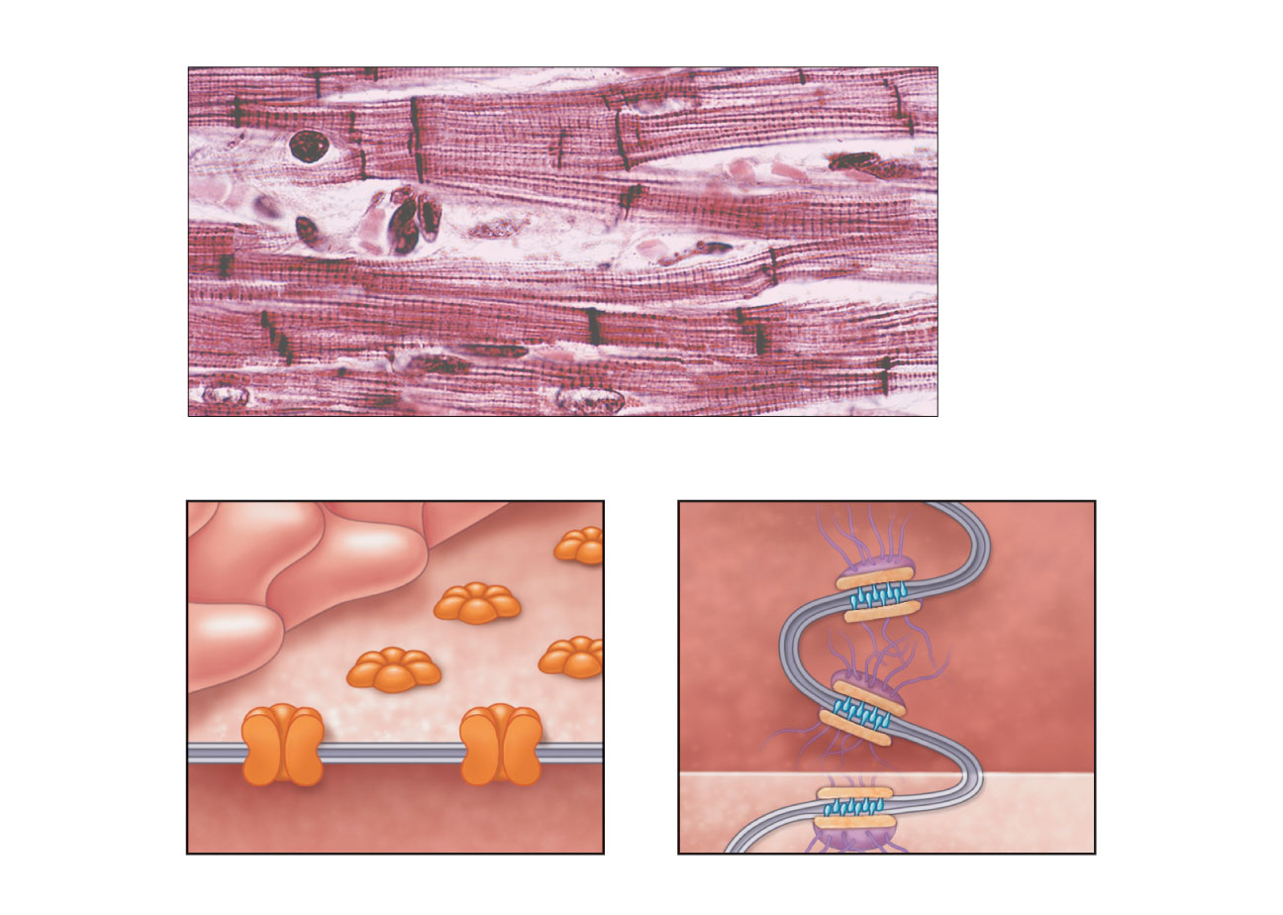
Nucleus
Intercalated discs
Cardiac muscle cell
Gap junctions
Desmosomes
(a)
Figure 18.11a

Slide 41
Microscopic Anatomy of Cardiac Muscle
Intercalated discs: junctions between cells anchor cardiac cells
  Desmosomes prevent cells from separating during contraction
  Gap junctions allow ions to pass; electrically couple adjacent cells
Heart muscle behaves as a functional syncytium

Slide 42
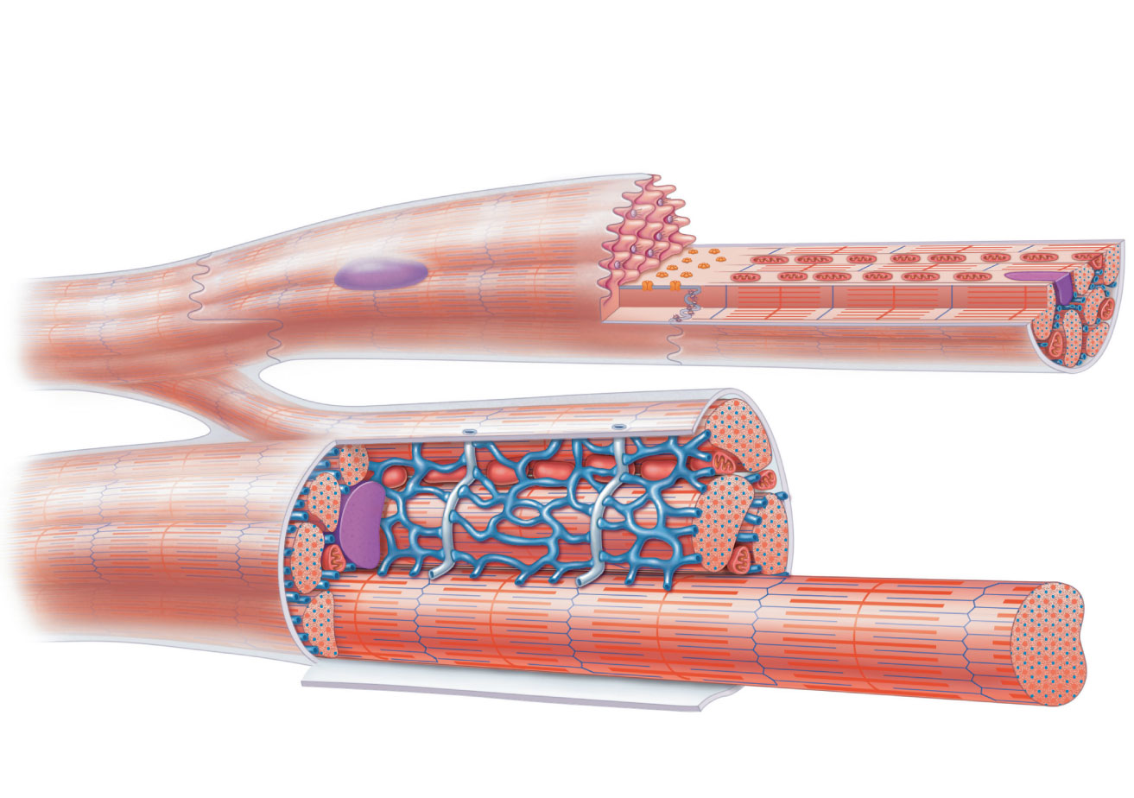
Cardiac
muscle cell
Mitochondrion
Intercalated
disc
Nucleus
T tubule
Mitochondrion
Sarcoplasmic
reticulum
Z disc
Nucleus
Sarcolemma
I band
I band
(b)
A band
Figure 18.11b

